Slide 1
Geothermal Project Management February – March 2024
Day 3 Session 3
Reservoir Engineering Concepts
Michael Gravatt and Team
Engineering Science & Geothermal Institute
University of Auckland, New Zealand

Slide 2
Reservoir engineering tasks
Understand what is going on underground (permeability structure, temperatures and pressures)
Carry out and interpret various well tests
Suggest monitoring and testing programs
Help optimise and manage the reservoir performance

Slide 3
Topics covered
Geothermal systems
Discussion of heat and mass underground
Darcy’s Law and implications
Downhole measurements
(Quite a lot of background theory to help understanding of geothermal reservoir behavior)

Slide 4

Geothermal Modelling Group
Created by Professor Mike O’Sullivan
Led by Professor Mike O’Sullivan and Dr John O’Sullivan
The largest dedicated geothermal reservoir modelling team in the world
9 full-time geothermal reservoir modelling consultants
2 additional full-time specialists in modelling uncertainty
5-6 international interns annually
High quality geothermal modelling PhD candidates and Masters students also contribute

Slide 5
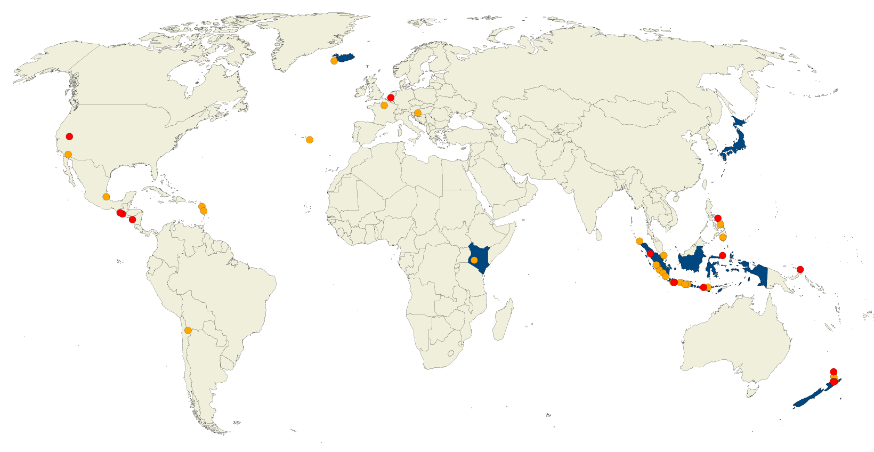
Geothermal Modelling Group

Slide 6











Geothermal Modelling Group
Modellers/consultants/researchers
Uncertainty quantification
Software developers
Group leaders

Slide 7
Types of geothermal systems
At geothermal areas the heat flow is much larger than the world average of 60mW/m²
The type of geothermal system depends on the heat flow and the geological setting (discussed earlier)
They range from warm water systems where there is no fluid movement and no boiling up to convecting two-phase systems with lots of boiling underground

Slide 8
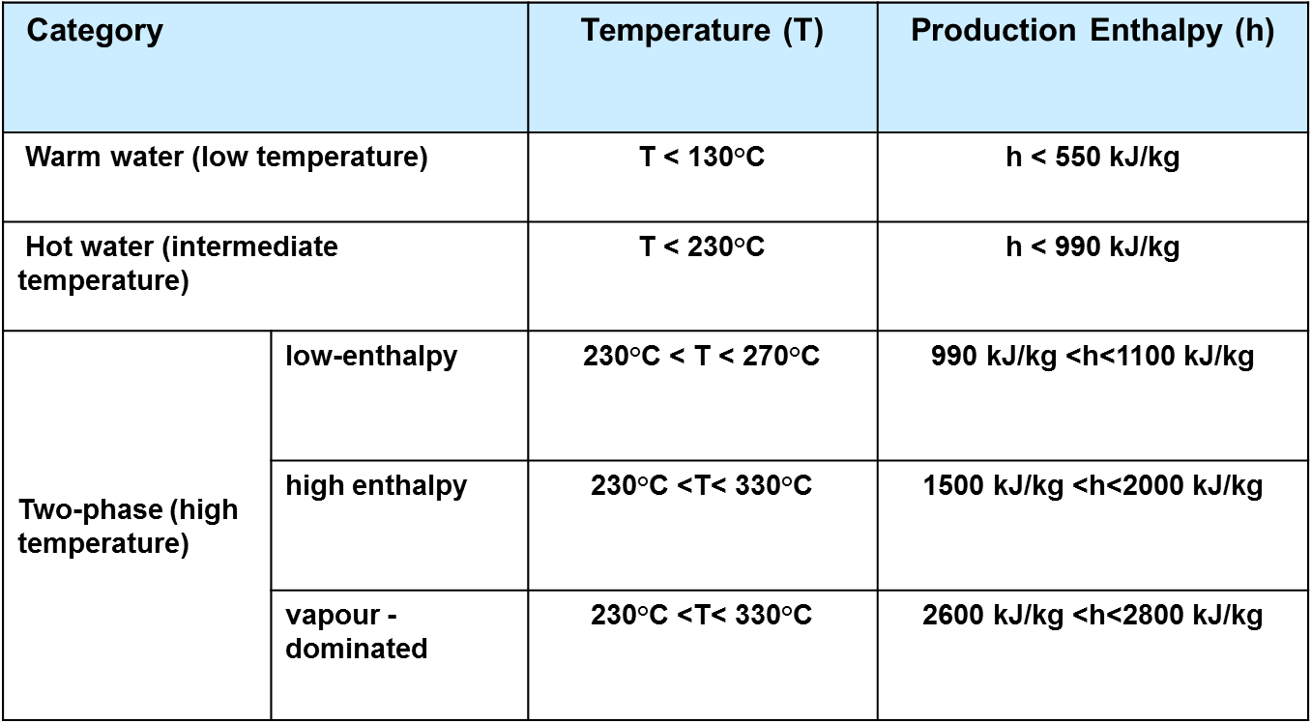
Approximate thermodynamic classification of geothermal systems

Slide 9
Approximate thermodynamic classification of geothermal systems

Slide 10
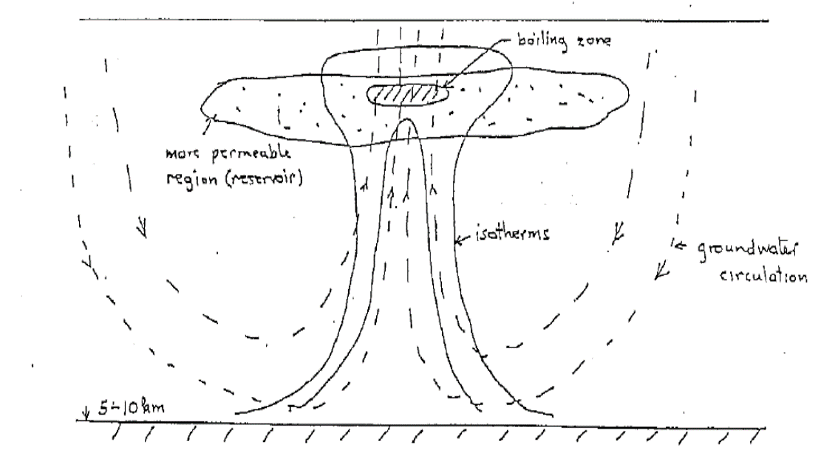
Convective geothermal system

Slide 11
Heat transfer mechanisms in geothermal systems
Conduction:
Heat flow = conductivity x temperature gradient
Convection:
Heat flow = mass flow x enthalpy
Counter-flow:
Heat flow = steam rising – water trickling down

Slide 12
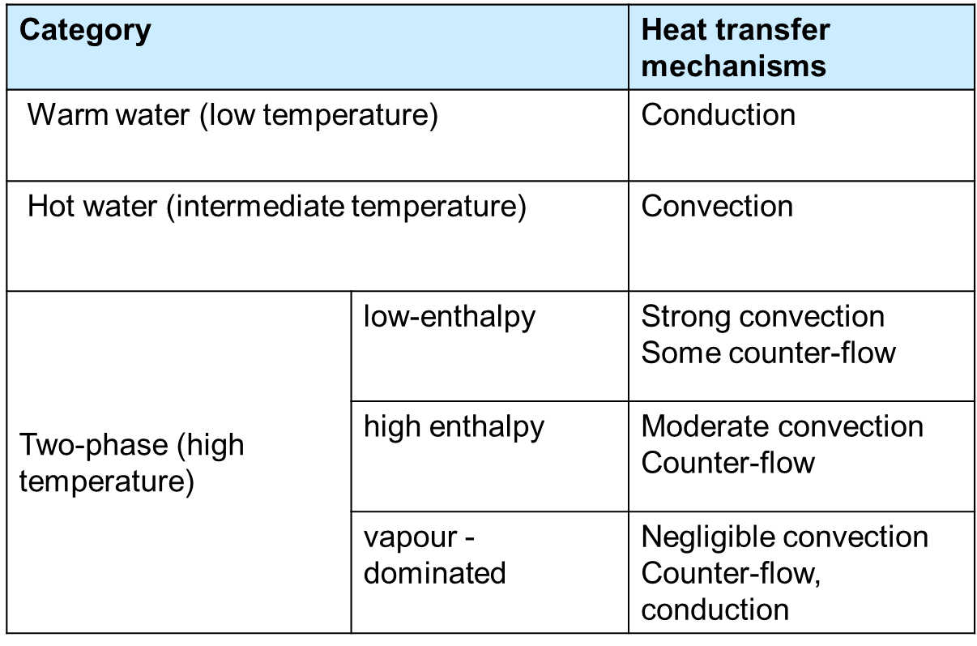
Heat transfer in geothermal systems

Slide 13
Geothermal reservoirs
A geothermal reservoir is quite different from an oil or gas reservoir, or even a ground water reservoir.
First, a geothermal reservoir is usually not a clearly defined highly permeable region confined by low permeability strata;

Slide 14
Geothermal reservoirs
Secondly the quantity to be extracted, namely heat energy, is not contained entirely in the reservoir fluid.
In an oil reservoir, once the oil has been extracted the reservoir is exhausted, but in a geothermal reservoir the water (or steam) which was originally in the reservoir can be replaced by surrounding cooler water which is heated by the reservoir rock and then becomes available for production.
This process of recharge is very important in the behaviour of geothermal reservoirs.

Slide 15
Geothermal reservoirs
This process of recharge is very important in the behaviour of geothermal reservoirs.

Slide 16
Reservoir engineering parameters
The most important reservoir parameters are porosity and permeability
Porosity measures how much pore space is available in the rock matrix
Permeability measures how well the pore space is connected (often related to the amount of fracturing)

Slide 17
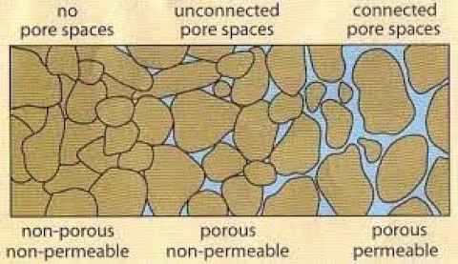
Porosity and permeability
Porosity and permeability can be primary (matrix) or secondary (fractures)
Rock grains
Rock grains
Primary porosity

Slide 18
Reservoir engineering parameters - porosity
Porosity φ is defined as the ratio of volume of pore space (i.e. the volume that can be occupied by the fluid) to the total volume of the system.
Porosities are of the order 5 -30% in the production zone of a geothermal reservoir.
However in the tighter surrounding rock porosity may be 1 % or lower.

Slide 19
Reservoir engineering parameters -volume flux and fluid velocity v, u
The volume flux or Darcy velocity, v, is the flow rate per unit cross-sectional area of the porous medium.
The average velocity at which the fluid actually flows through the porous medium is known as the interstitial velocity, u. This is the particle velocity.

Slide 20
Relationship between volume flux v and fluid velocity u
Here A is the cross-sectional area of the channel, v is the x-component of the volume flux v and Δx is the distance along the channel the injected fluid particles move during time Δt.
Rearranging the formula above gives an expression relating the volume flux to the particle velocity

Slide 21
Relationship between volume flux v and fluid velocity u
Thus in general
Here v has units of velocity, namely distance/time. Typically the flux velocity is of the order 10⁻⁶ m/s.
In geothermal reservoir engineering usually mass flow F_{m} rather than volume flow v is used. For single-phase flow of hot water it is related to the volume flux by
Note that in calculating movement of chemicals, such as tracers or chlorides, the particle velocity u must be used

Slide 22

Reservoir engineering parameters - permeability
We have to define a parameter which tells us how easy it is for fluid to flow through a porous medium (e.g. fractured rock).
This parameter is known as the permeability, k, and is defined by an empirical relationship known as Darcy's law, which can be expressed for one-dimensional flow of cold or warm water by (more details given later)
$$v=\frac{k}{μ}\left(−\frac{dp}{dx}\right)$$

Slide 23


Reservoir engineering parameters - permeability
The constant of proportionality is k/μ, the permeability divided by the dynamic viscosity of the fluid.
For the same pressure gradient, a medium with a high permeability will allow a higher flux velocity than one with a lower permeability (k/μ is sometimes called the mobility in petroleum engineering).
In terms of mass flux Darcy's law becomes
$$F_{m}=\frac{k}{ν}\left(−\frac{dp}{dx}\right)$$
$$ν=\frac{μ}{ρ}$$
Kinematic viscosity

Slide 24
Reservoir engineering parameters - permeability
Permeability may be directional; that is, larger in one direction. A system such as this is said to be anisotropic.
One in which the permeability is the same in all directions is said to be isotropic. Geothermal systems frequently have anisotropic permeability.
The units of permeability are those of area, i.e., m².

Slide 25
Reservoir engineering parameters - permeability
Typical values of permeability in a geothermal system are of the order 10⁻¹⁴ m², with vertical permeability perhaps 4-5 times smaller.
One special unit often used is the darcy which is approximately equal to 10⁻¹²m²
Or the millidarcy which is approximately equal to 10⁻¹⁵m². Typical values of permeability for geothermal systems are shown below

Slide 26
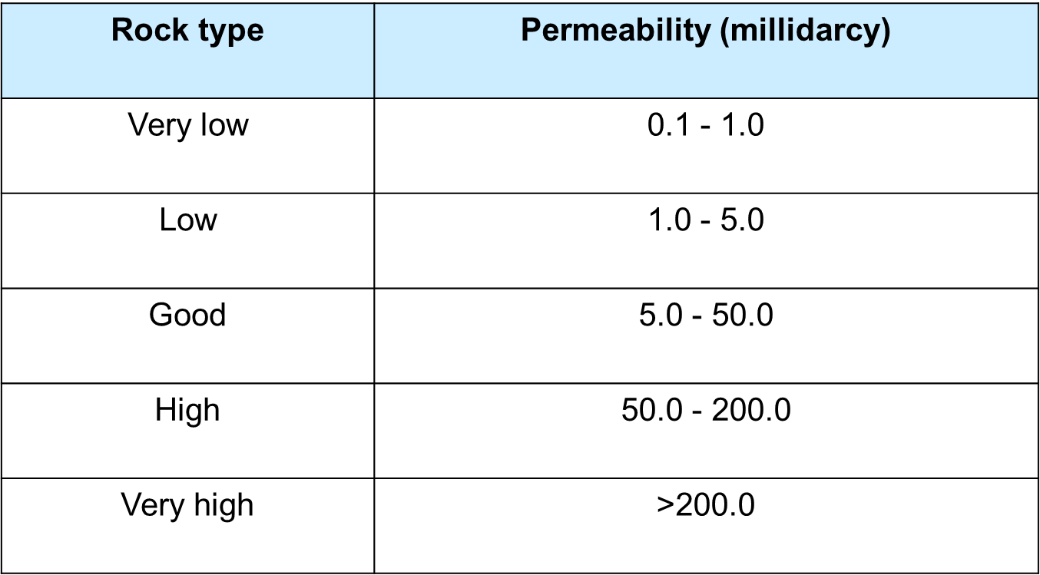
Reservoir engineering parameters - permeability

Slide 27
Porosity and permeability
Porosity and permeability can be primary (matrix) or secondary (fractures)
Rock grains
Rock grains
Primary porosity
Low 2nd porosity, Low 2nd perm
High 2nd porosity, Low 2nd perm.
High 2nd porosity, High 2nd perm.

Slide 28
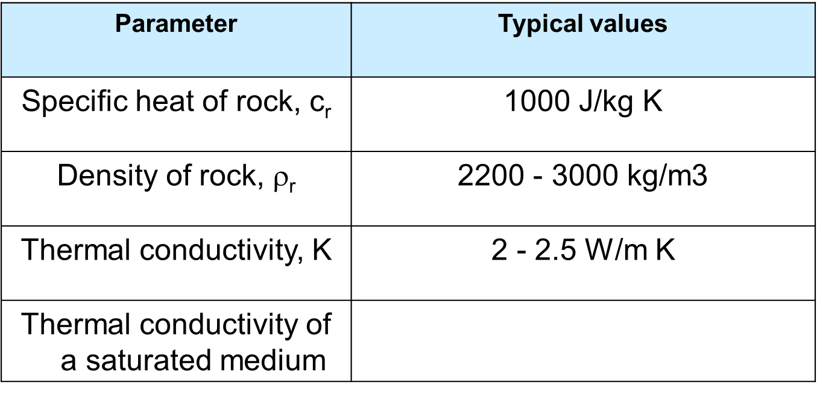
Other reservoir engineering parameters

Slide 29
Heat and mass underground
Mass. The amount of water and steam underground, per unit volume of the reservoir, is given by
Here φ is the porosity, ρ_{l} and ρ_{v} are the densities of the liquid and vapour (or gas) phases, respectively, and S_{l}, S_{v} are liquid and vapour saturations, respectively.
Amount of liquid
Amount of vapour

Slide 30
Saturations
The saturations S_{l}, S_{v} are the volume fractions of liquid and vapour.
They are commonly used in reservoir engineering to measure the proportions of water and steam
Whereas for surface equipment engineering, "dryness" is usually used.
Note:

Slide 31
Heat and mass underground
Similarly the energy content is given by
Here ρ_{r}, c_{r} are the rock density and rock specific heat respectively and u_{l}, u_{v} are the specific internal energies for liquid and vapour.
Energy in the rock is much more significant, but heat is transported in the fluid
Energy in the rock
Energy of the fluid

Slide 32
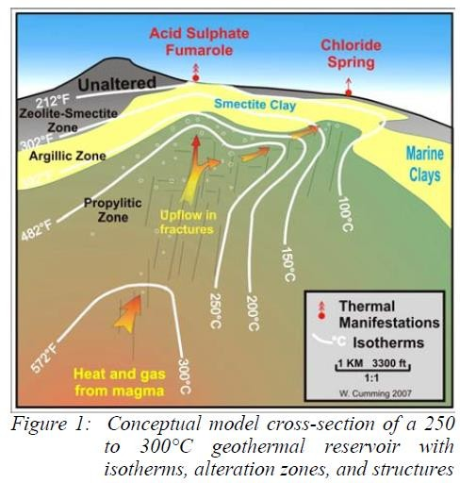
Stored heat calculations
A simple method for calculating the production potential of a geothermal reservoir is to carry out a stored heat calculation.
Volume:
@ 240 °C

Slide 33
Stored heat calculations
A simple method for calculating the production potential of a geothermal reservoir is to carry out a stored heat calculation.
Reservoir Temperature (°C)
Rock density (m³)
Ambient Temperature (°C)
Reservoir area (m²)
Rock specific heat (kJ/kg/K)
Thermal energy (kJ)
Reservoir thickness (m)

Slide 34
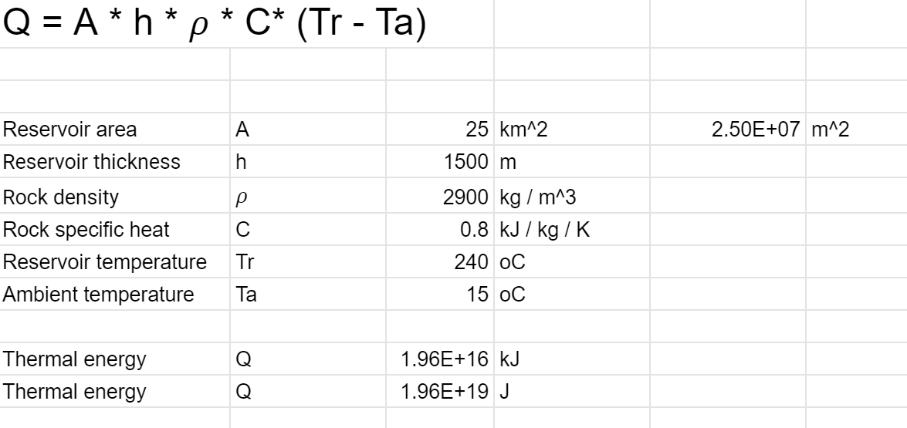
Stored heat calculations
Energy in the system

Slide 35
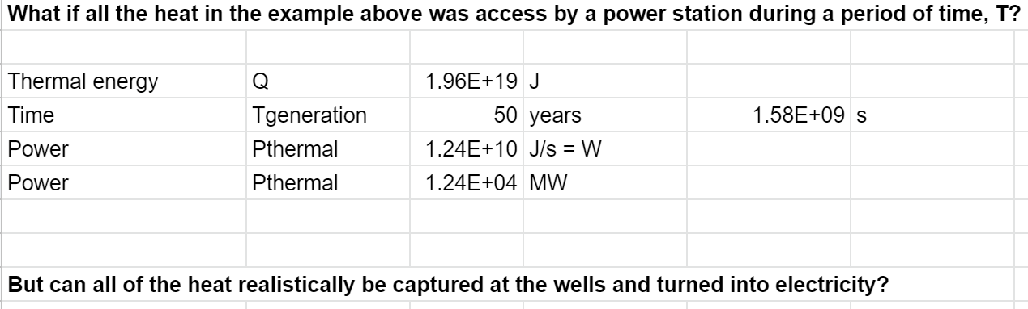
Stored heat calculations

Slide 36

Stored heat calculations
Electrical power output is obtained by combining the recovery factor ($r$), efficiency ($\text{η}$) and parasitic losses.
Which for our example gives 188 MW with $\text{η}$ = 15.5%, $r$ = 10% and P_{parasitic} = 4 MW.
P_{e} = η r P_{Thermal} – P_{Parasitic}
But what if we don’t know all these values?

Slide 37
Stored heat calculations
The problem is that the magnitude of the recovery factor is unknown.
Values in the range 0.1 - 0.5 have been suggested by various authors but no really convincing reasons have been given for the choice.
Some workers have suggested that the calculation of the final energy should not be based on a final state of the reservoir containing cold water, because the reservoir will cease useful production when the final temperature is at some higher value, say ~180ºC for electricity production.

Slide 38
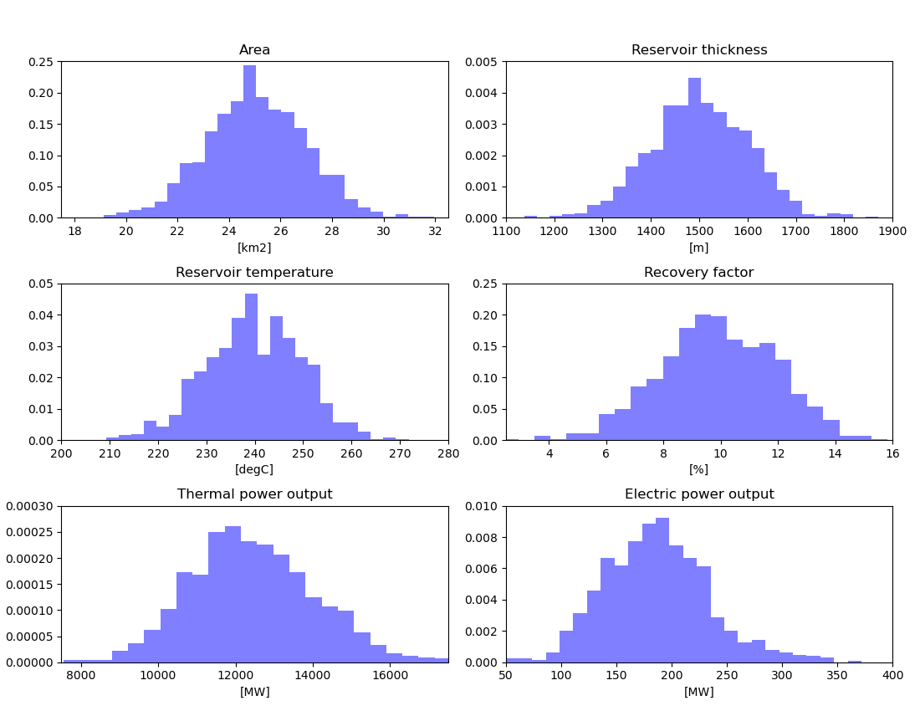
Example: Stored heat calculation
Inputs
Outputs
38

Slide 39
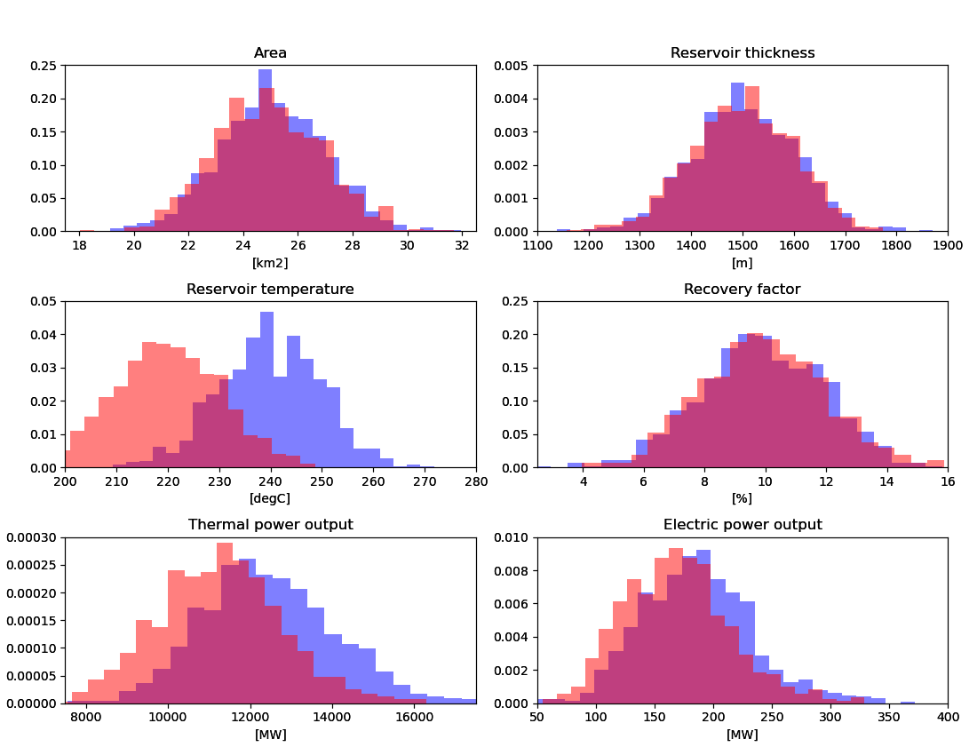
Example: Stored heat calculation
What happens if the average reservoir temperature is lower?
Inputs
Outputs
39

Slide 40
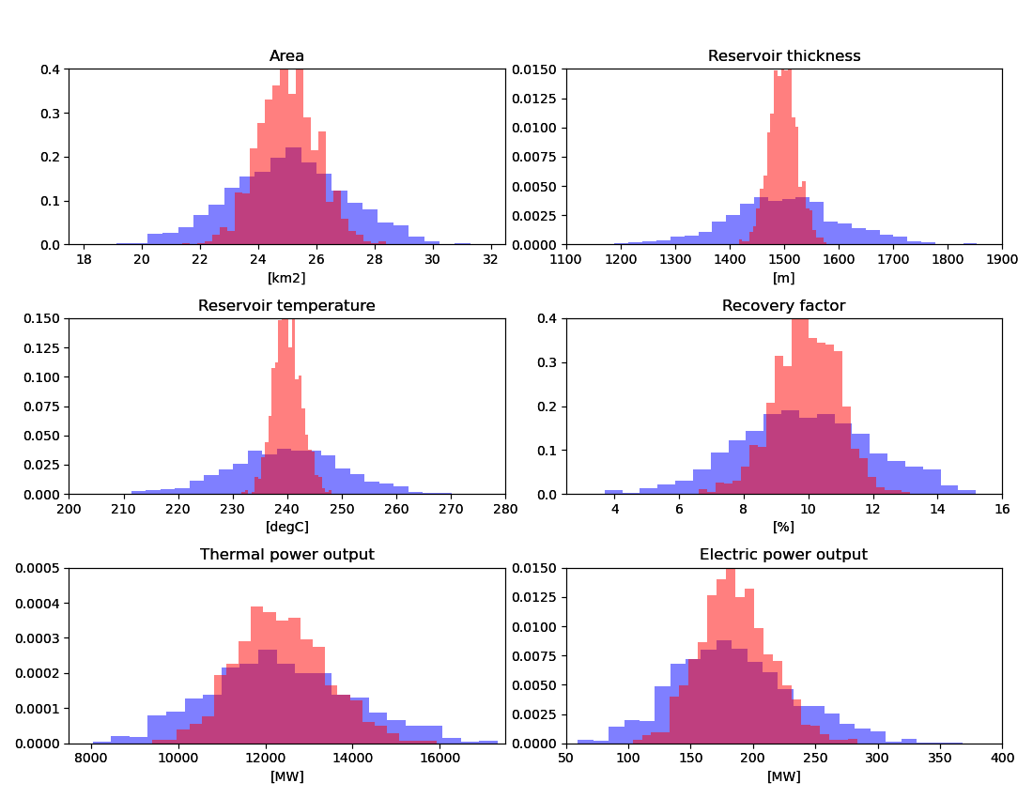
Example: Stored heat calculation
What happens if we were more certain about the reservoir parameters?
Inputs
Outputs
40

Slide 41
Flow in geothermal reservoirs - Darcy’s Law
In 1856, Henry Darcy, a French hydraulic engineer, reported that he had found that the flow rate in a porous medium is proportional to pressure difference and inversely proportional to the length of the flow path.
Thus

Slide 42
Darcy’s Law Experiment
p₂
p₁
Q
l

Slide 43
Darcy’s Law
Darcy introduced the permeability k
Volume
Mass

Slide 44
3D version of Darcy’s Law
X-direction
Y-direction
Z-direction
(z is measured vertically upwards in my notation)
Effect of gravity

Slide 45
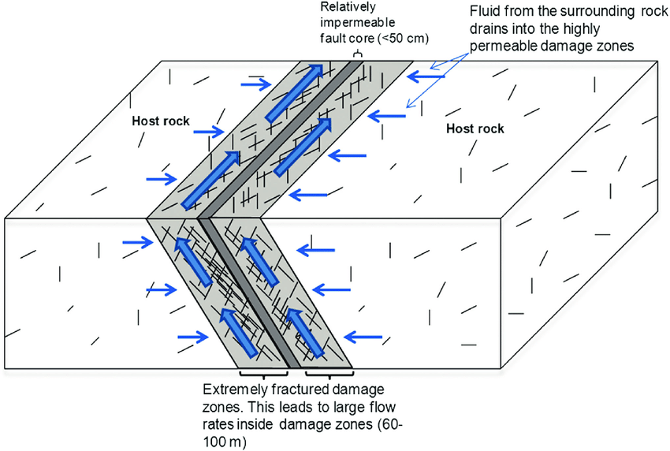
3D permeability
k_{y}
k_{x}
Johri et al. 2014
k_{x} < k_{z} < k_{y}
k_{z}
Anisotropic Permeability

Slide 46
Anisotropic, 3D version of Darcy’s Law
X-direction
Y-direction
Z-direction
Permeability and hence flow can be different in each direction e.g. along faults, between different formations etc.

Slide 47
Groundwater notation
In groundwater studies, reservoir engineers usually use head rather than pressure
Total head
Pressure measured in terms of depth of water
Elevation

Slide 48
Groundwater notation- 3D Darcy’s Law
The gradient in head is what drives the flow. Water flows down hill and from high to low pressure.
Because of the temperature differences and therefore density differences head is not a useful quantity to use in geothermal reservoir engineering. We use pressure instead.

Slide 49
Groundwater vs Geothermal
Geothermal flows are non-isothermal
Boiling can occur
Vertical flows are more important in geothermal fields
Coupling of heat and mass flows

Slide 50
Two-phase version of Darcy’s Law
The basic idea is that the two phases, water and steam, interfere with one another
The same kind of process occurs in an oil reservoir where gas and liquid oil may both be present
A separate Darcy’s Law equation is written for each phase

Slide 51
Two-phase version of Darcy’s Law
Water
Steam
Total
Relative permeability between 0 and 1

Slide 52
Relative permeabilities
The relative permeabilities or permeability reduction factors k_{rl}, k_{rv} account for the fact that the liquid and vapour phases interfere with one another as they move through the fractured rock matrix.
The exact forms of k_{rl} and k_{rv} are not really known but it is known that they depend on the liquid saturation

Slide 53
Relative permeabilities
This interference between the phases is one of the most important aspects of two- phase flow in a porous material.
At high liquid saturations the liquid (water) flows while the vapour (steam) remains immobile.
At low saturations the liquid becomes immobile and the vapour moves.

Slide 54
Relative permeability curves
Corey curves for S_{lr} = 0.30, S_{vr} = 0.05

Slide 55
More relative permeability curves
Linear curves for S_{lr} = 0.30, S_{vr} = 0.05

Slide 56
Energy flow
Darcy's Law also affects the calculation of the energy flux.
For single phase flow of hot water the energy flux is given by
Here h_{l} is the enthalpy and K is the thermal conductivity
Convection
Conduction

Slide 57
Energy flow
For a two-phase flow of water and steam it is given by
Convection
Conduction

Slide 58
Energy and enthalpy
For a static sample use internal energy, but for a moving fluid use enthalpy
enthalpy
internal energy

Slide 59
Simple flows
We will now look at simple flows and the implications of Darcy’s Law
First we will consider 1D radial flow towards a geothermal well

Slide 60
Flow towards a well
feed zone
Horizontal, radially symmetric flow

Slide 61
Plot of effective kinematic viscosity (using Corey’s curves)
Viscosity depends on the proportion of vapour and liquid, highest when both are present. This affects the fluid flow underground.

Slide 62
Two-phase flowing enthalpy (using Corey’s curves)
Choice of relative permeability curves affects the flow enthalpy predicted.

Slide 63
Temperature profiles
A
B
C
D

Slide 64
1D vertical flow in upflow zones

Slide 65
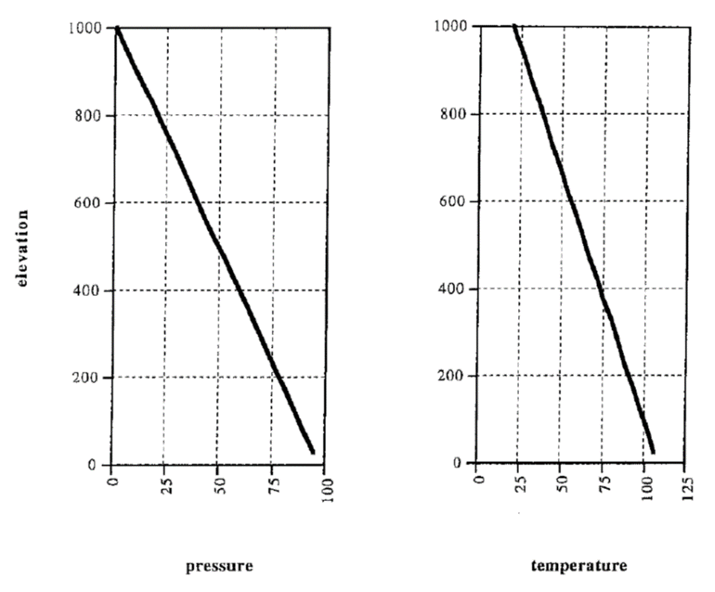
Warm water systems

Slide 66
Hot Water Systems
For most of the upflow zone the temperature gradient is very small; h_{l} remains approximately constant as the pressure p changes, while the temperature T remains approximately constant.
Near the surface the temperature decreases rapidly and the conductive transfer increases to match the decrease in h_{l}.

Slide 67
Hot water upflow zone
conduction
convection

Slide 68
Two-phase upflow zone
Where a boiling zone occurs the temperatures and pressures are close to the boiling-point-with-depth curve.
A small amount of energy is transported by conduction but most is moved by counter-flow of water falling and steam rising.
Above the two-phase zone a liquid condensate layer occurs, with large temperature gradients transporting most of the heat.

Slide 69
Two-phase upflow zone
Pressures follow a slightly greater than hydrostatic gradient.
At depth (deep brine) the liquid zone requires large temperature gradients to produce a large energy flux accompanied by a small mass flux.

Slide 70
Two-phase upflow zone

Slide 71
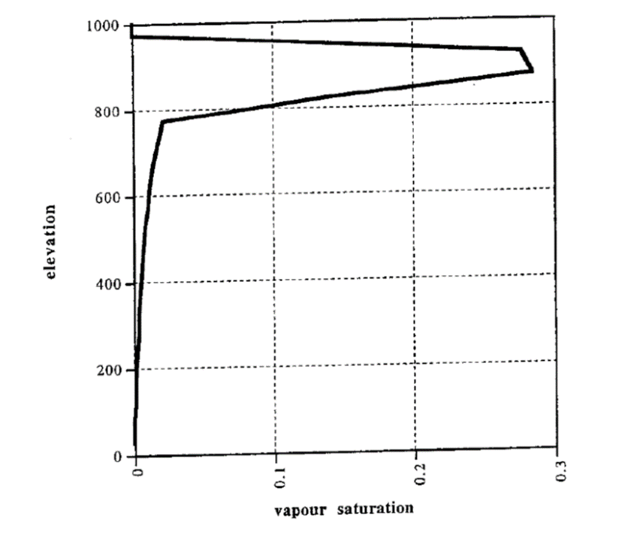
Saturation in upflow zone

Slide 72
Profiles for a vapour dominated system

Slide 73
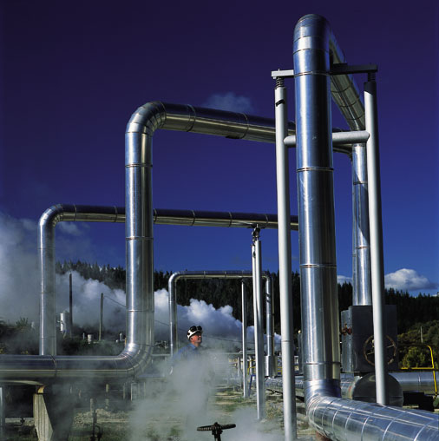
Well-test analysis

Slide 74
Completion test
Often done soon after drilling is finished
Inject cold water (often change rate during test – step rate up or down)
Carry out pressure-temperature-spinner (PTS) run
Deduce location of feedzones from changes in spinner signal and changes in temperature
Allow well to warm up. Carry out repeat PT runs
Deduce reservoir temperature profile from 2-3 week warm-up curves

Slide 75
Spinner data
From Hole, 2008

Slide 76
Temperature data
From Hole, 2008

Slide 77
Warm-up curves
From Hole, 2008

Slide 78
Downhole temperature profiles
After the completion test and a warm-up period (2-3 weeks) stable down-hole temperatures can be measured
Downhole temperature profiles may require interpretation as well temperatures and reservoir temperatures may not be the same (e.g. internal flows, wells on bleed)

Slide 79
Down-hole temperature profiles
Could be down-flow

Slide 80
Down-hole temperature profiles
Steam upflow

Slide 81
Down-hole temperature profiles
Boiling point for depth curve

Slide 82
Transient well tests
Used by reservoir engineers to diagnose reservoir performance
Control flow rate in a well
Measure downhole pressure in the same well or a nearby well
From a plot of pressure vs time (semi-log or log-log) calculate kh (permeability-thickness product) and φCh (porosity-compressibility-thickness)
Sometimes estimate other parameters (skin, wellbore storage, boundary effects)

Slide 83
Transient well tests
Common tests
Drawdown/buildup
Injection/falloff
Interference
In geothermal, buildup, falloff and interference tests are the most common
Usual methods of analysis may not work because of boiling and condensation – use a simulator instead

Slide 84
Well test analysis (continued)
The most important parameter is D the diffusivity
It measures how fast pressure changes spread around a reservoir. For a hot water reservoir both the water and rock compressibility are very small. Thus pressure changes spread a long way, very fast
Flow parameters
storage parameters

Slide 85
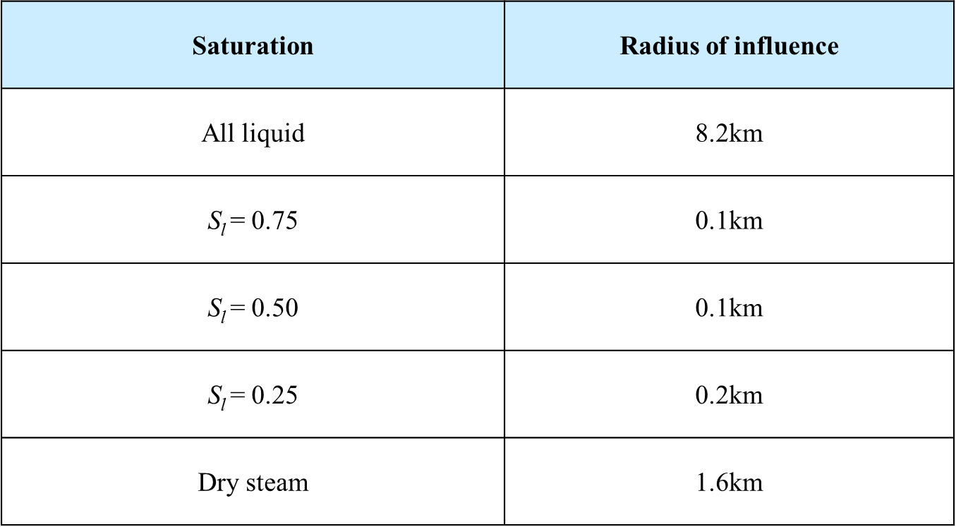
Well test analysis (continued)

Slide 86
Output tests
Measure flow rate, well-head pressure and often enthalpy
Useful for showing change in reservoir conditions
From Grant, Donaldson & Bixley

Slide 87
Tracer tests
Tracer tests provide information on the nature and properties of connections, or flow-paths, between reinjection and production wells
These connections control the rate of cooling of the production wells during long-term reinjection of colder fluid
Thus tracer tests help to identify the possibility of “thermal break-through”
Thermal breakthrough time (onset of cooling) is usually several orders of magnitude (2–4) greater than the tracer breakthrough time

Slide 88
Liquid-phase tracers:
Halides such as iodide (I) or bromide (Br);
Radioactive tracers such as the isotopes iodide-125 (125I) and iodide-131 (131I);
Fluorescent dyes such as fluorescein and rhodamine;
Aromatic acids such as benzoic acid;
Naphthalene sulfonates.

Slide 89
Steam and two-phase tracers
Steam-phase tracers:
Fluorinated hydrocarbons such as R-134a and R-23;
Sulphur hexafluoride (SF6).
Two-phase tracers:
Tritium (3H);
Alcohols such as methanol, ethanol and n-propanol.

Slide 90
Tracer test results
Axelsson, 2013

Slide 91
Tracer test result
Axelsson, 2013

Slide 92
Monitoring data (well–by-well)
Mass flow
Production enthalpy
Downhole pressure
Chemistry (gas and/or chloride etc)

Slide 93
Things that go wrong
Pressures drop too low
Enthalpies decline (shallow wells and wells near the edge of the field)
Injection returns and thermal breakthrough
Chemical problems –calcite or silica deposition

Slide 94
Thank you!

